Slide 1
FRB Update
William Huang
(9/10/2020)

Slide 2
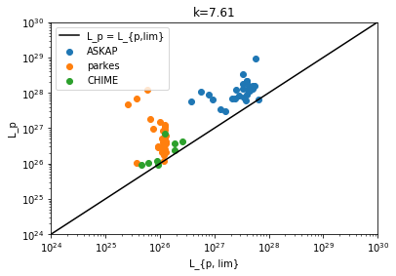
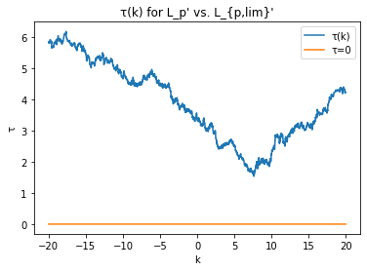
Old data (07/13, Update #7)
Previously, considering all of the telescopes and using their corresponding L_lim, the tau(k) graph never crossed 0 and had a minimum at k=7.61, a very high value.

Slide 3
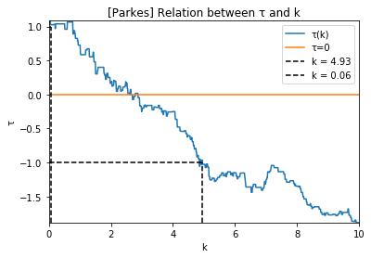
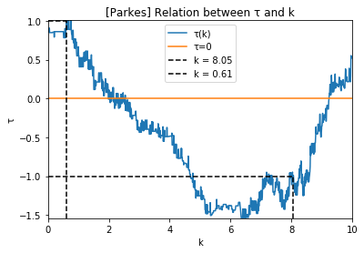
New data (Parkes only, 09/10)
L_p vs. z
τ=0 when k=2.6
L_p vs. L_lim
τ=0 when k=2.02

Slide 4
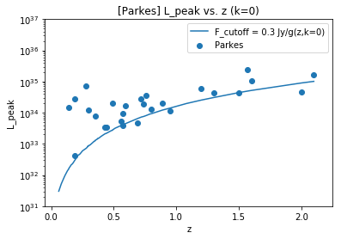
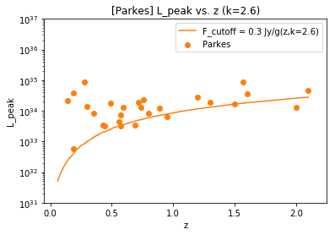
L_p vs. z, k=2.6

Slide 5
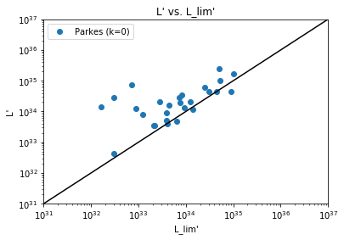
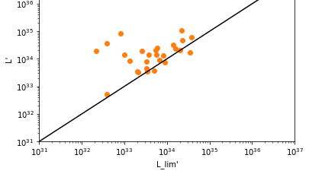
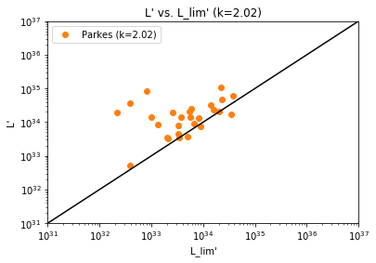
L_p vs. L_lim, k=2.02

